Slide 1
Cutpoint Determination Methods
Carter W. Daniels, PhD
Advisor – Statistics & Modeling
Eli Lilly & Co

Slide 2
Outline
About me
What is a cutpoint analysis for antidrug antibodies (ADA)
ADA cutpoints in gene therapy
Typical Devanarayan et. al. (2017) workflow with outlier analysis
Extreme Value Theory approach for cutpoint determination (Pugh et al. 2024)
Bayesian Approach (LeBlond et al. 2022)
Results comparing typical, EVT, and Bayesian approach
A mixture model proposal for ADA capsid responses
Conclusions

Slide 3




About Me
University of Kentucky (BA)
Foundation skills: Animal Behavior & Experimental Design
Lilly/Prevail Papers:
Sevigny et al. (2023) GRN gene therapy
Ahuja et al. (In prep) Comparability of two gene therapy CMC processes
Arizona State University (MA, PhD)
Foundation skills: Statistics/Computational Modeling & Neuroscience
ASU Modeling Papers:
1. Daniels & Sanabria (2017): Concatenated Static & Dynamic Mixture Models
2. Daniels & Sanabria (2018): Reinforcement-learning explains gambling
3. Daniels et al., (2018) Bayesian Dynamic Mixture Models
Columbia University & Barnard College Post-doc
Foundation skills:
Statistics & Behavioral Pharmacology
Columbia Modeling Papers:
Daniels & Balsam (2023) Reinforcement learning model of auditory signal detection
Thrailkill & Daniels (2024) Mixture models of habit structure
Jiminez et al. (submitted) Bayesian Behavioral Economics
Eli Lilly/Prevail
Foundational Skills: Combing skill sets to help drive forward gene therapy drug development for neurodegenerative disorders
Stats Courses
ANOVA & Experimental Design
Regression Modeling
Linear & non-linear mixed-effects modeling’
Bayesian statistics
-In general, trained with the mathematical psychologist Federico Sanabria, PhD
Disease progression models
Bioassay qualification, development, bridging, comparability, cutpoints
Omics datasets
FDA submissions (pre-IND, INDs, IND amendments)

Slide 4
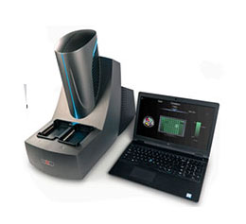
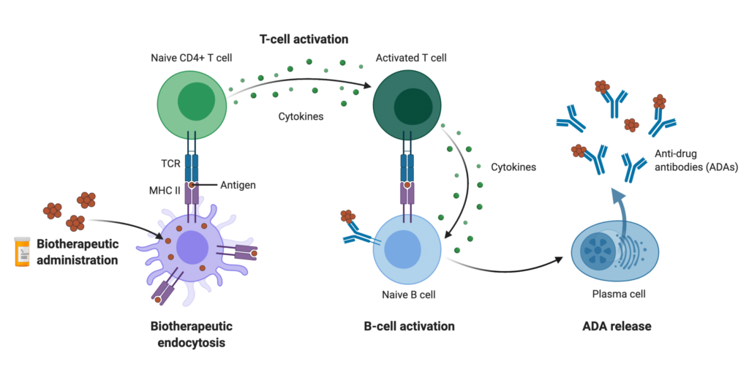

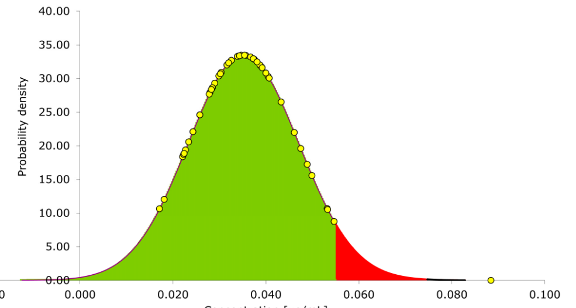
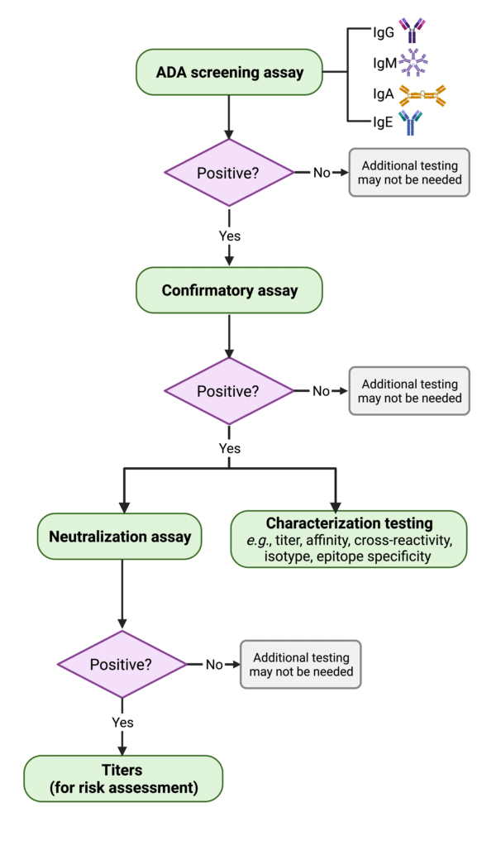
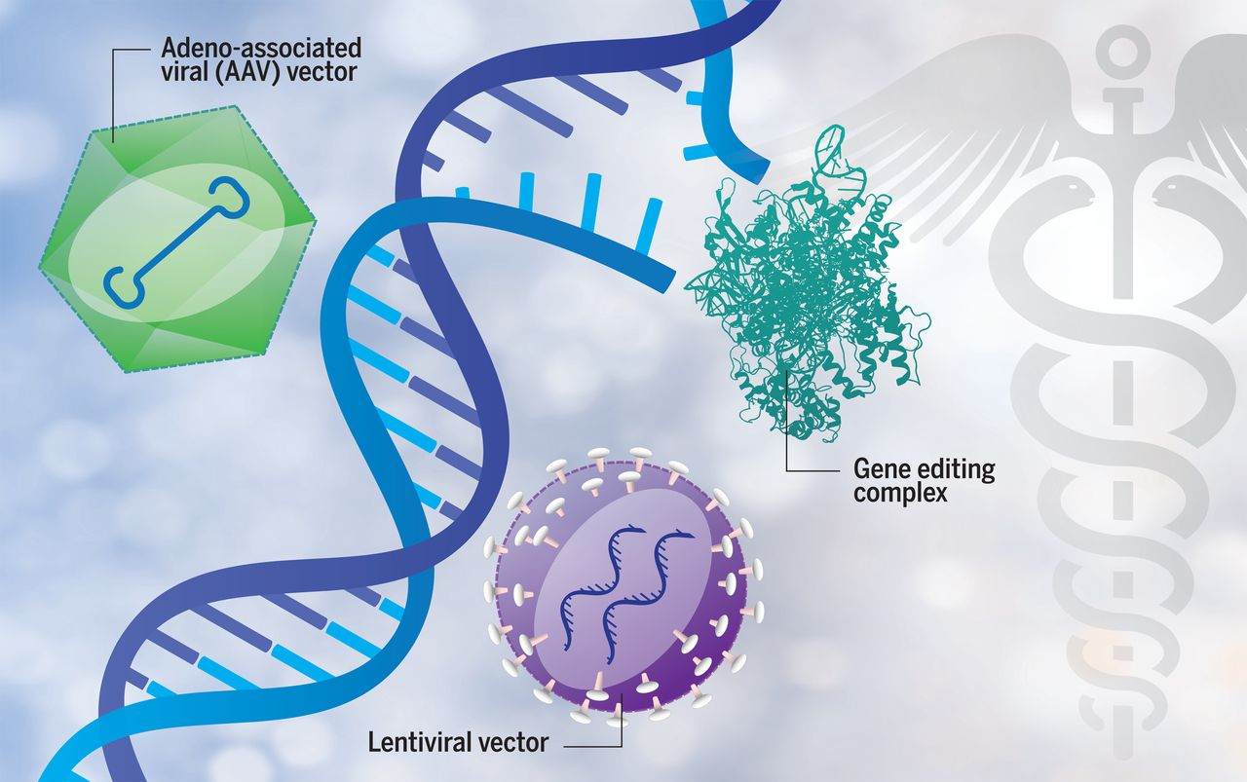
What is a cutpoint analysis?
A cutpoint is the threshold ($θ$) at which we categorize something moving from a negative (-) to a positive (+) state.
Cutpoints can be deployed in many different situations including whether an individual has anti-drug antibodies (ADAs).
Sample from population of drug-naive individuals
Prep samples, conduct assay
Wang & Gerpe, 2021; Rapid Novor
Conor Gearin, 2016; NewScientist
Mercodia
Conduct cutpoint analysis which results in…
Cutpoint Flowchart
Smeijsters et al. 2023
Dunbar et al. 2018
Wang & Gerpe, 2021; Rapid Novor

Slide 5
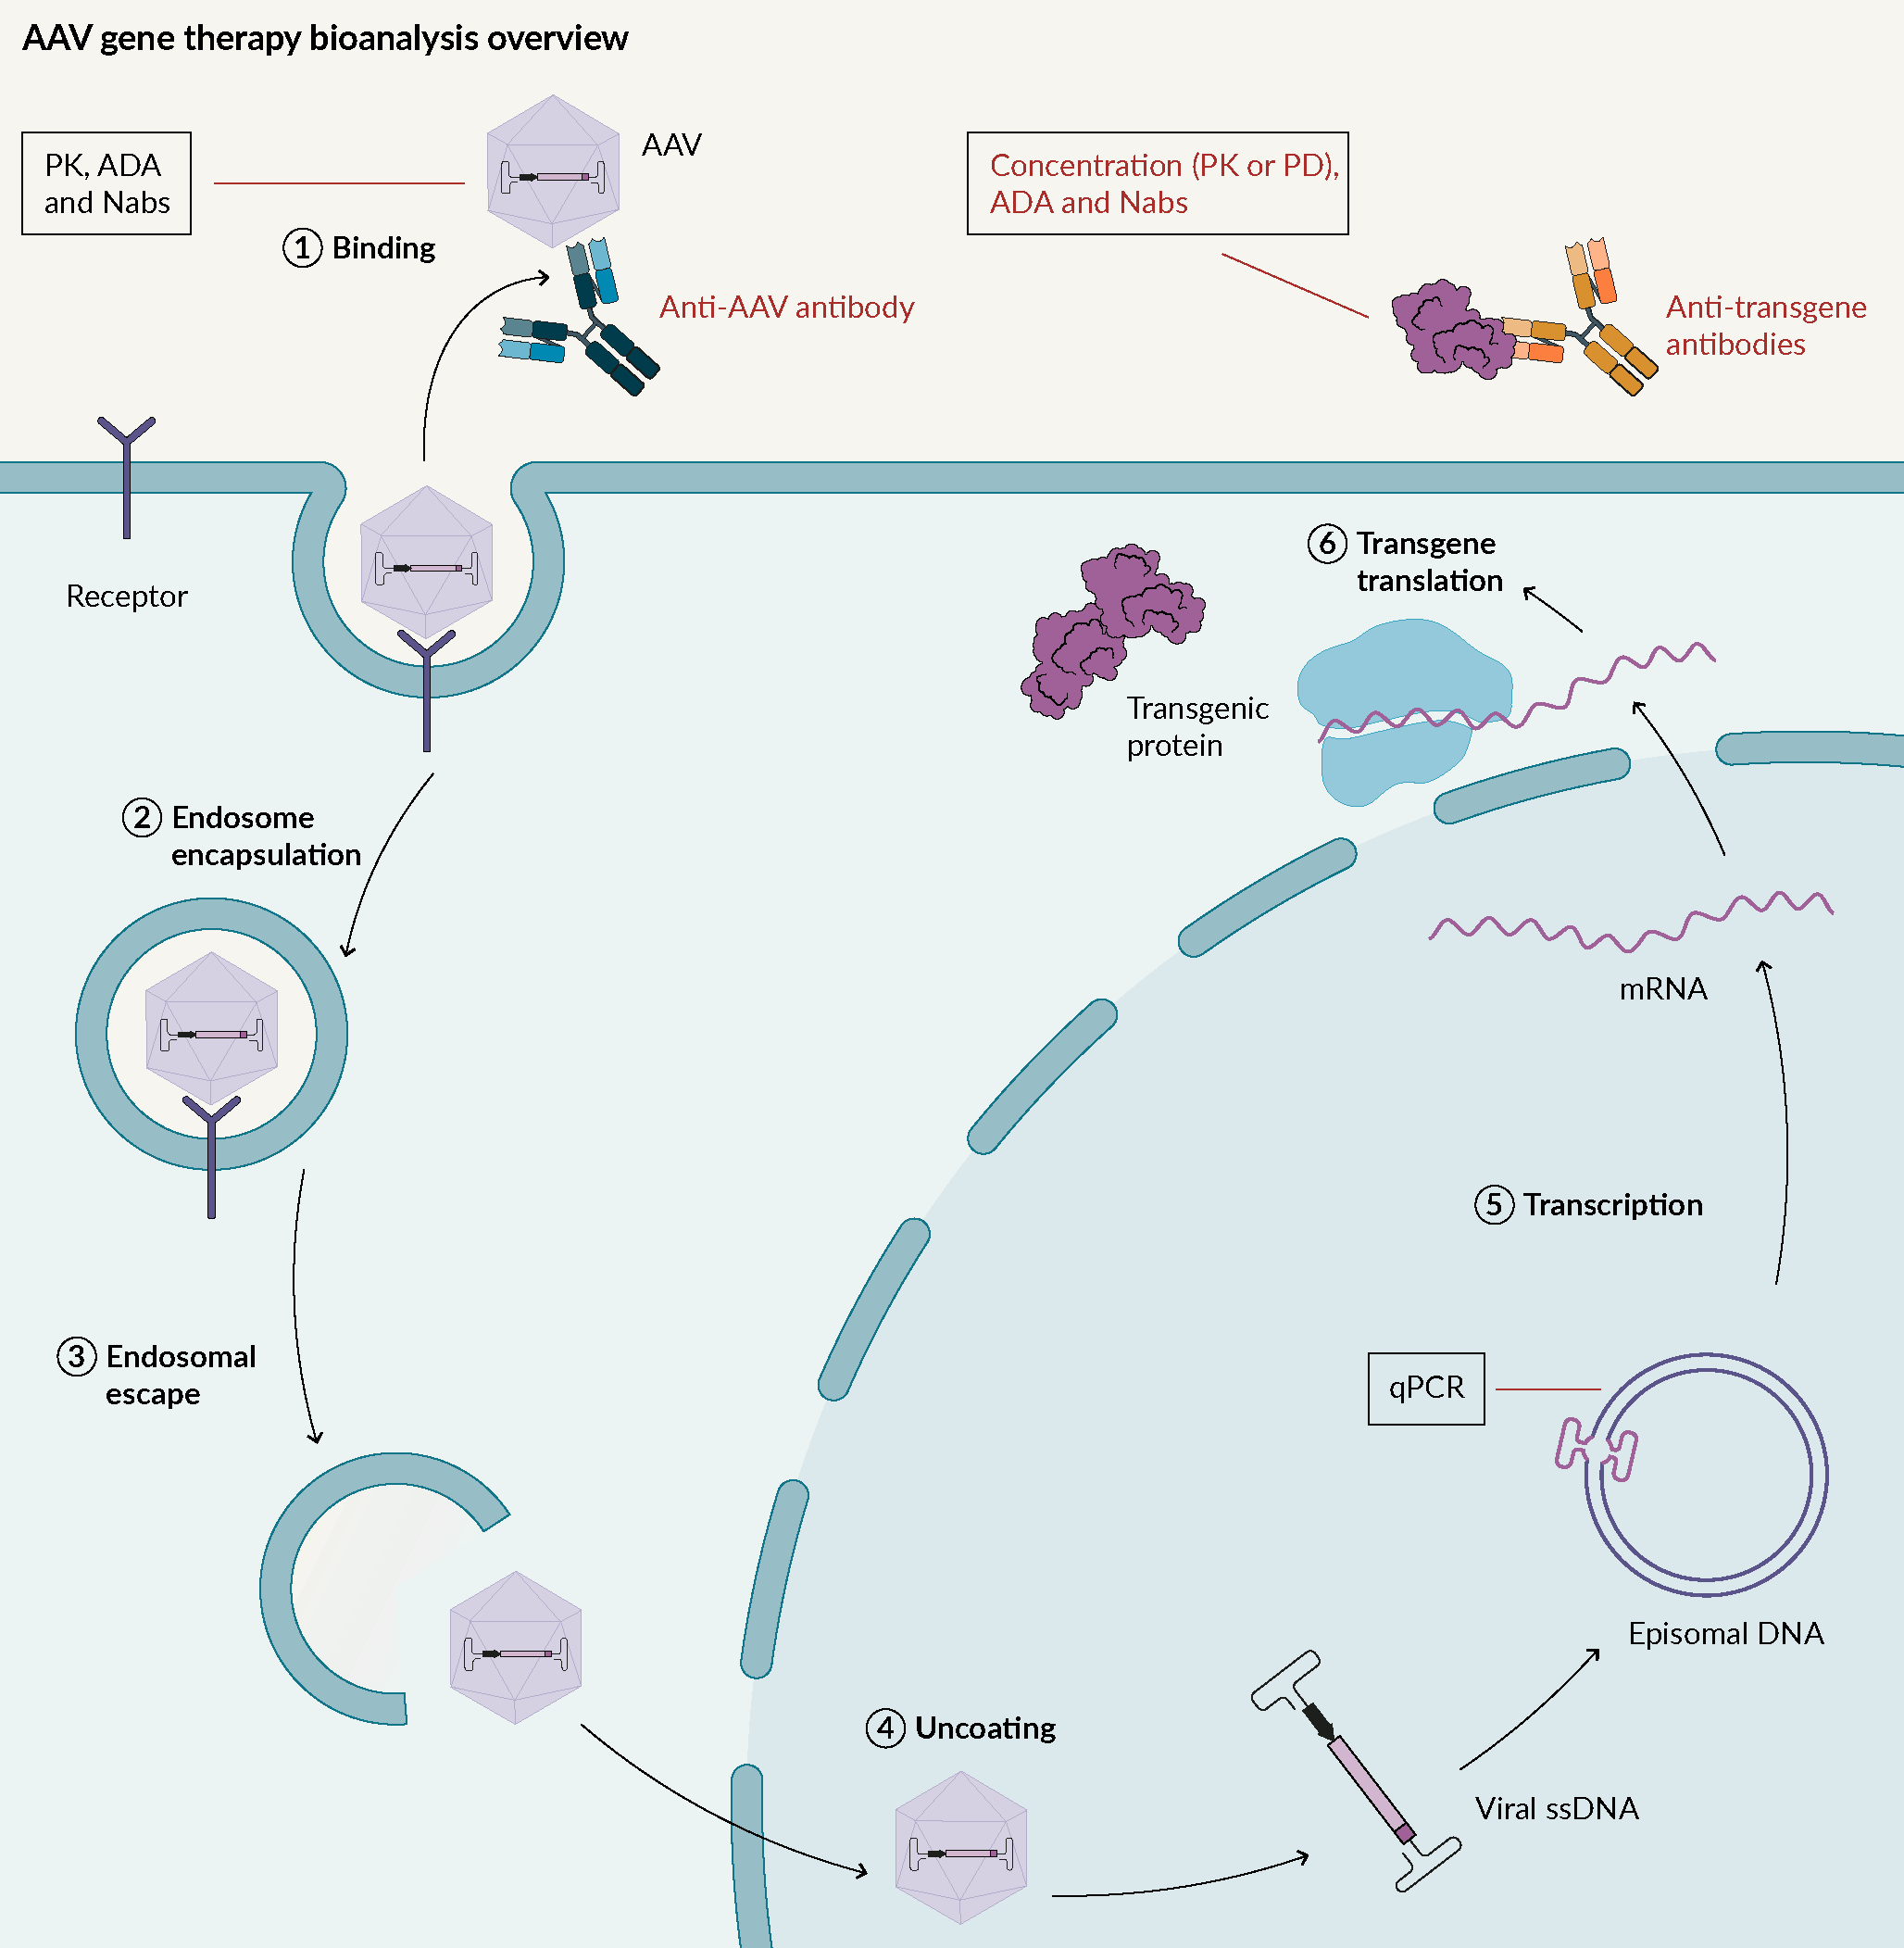
Cutpoint analyses for gene therapy products
Gene therapies are difficult because drug-naïve individuals may not be naïve to delivery vehicles despite being naïve to the transprotein.
Situation/Task: Lilly/Prevail asked me to help statistically define cutpoints for a transprotein ADA assay developed for an NHP-GLP study.
To do this I investigated,
The typical cutpoint approach
Alternative cutpoint approaches
And then worked cross functionally to decide which approach to use
Today I will build on this work by proposing a method for dealing with ADA to capsids
Jyamubandi (2023)

Slide 6

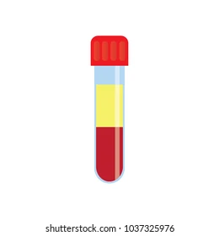
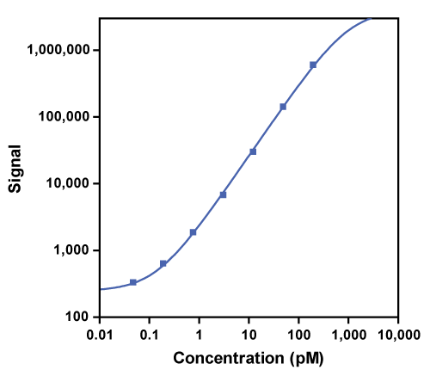
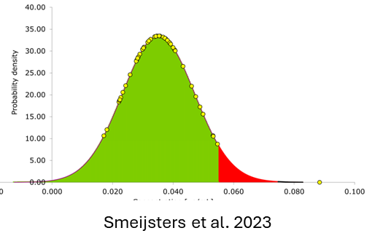
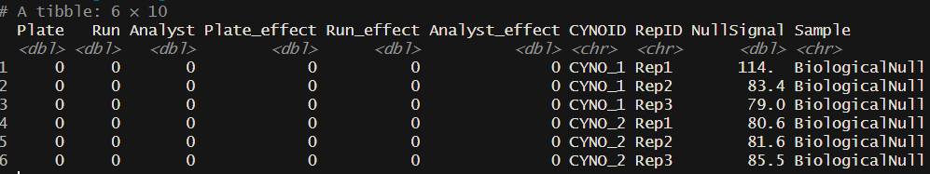
Cutpoint Workflow
30 Naïve NHP NC Samples
30 Naïve NHP Experimental Samples
Experimental Samples
NC, LPC, and HPC
Run in triplicate
Used to create a negative control pool
Screening samples: no drug
Confirmatory samples: ~ LLOQ drug
2 plates/run/analyst
2 runs
2 analyst
Standard Curve to interpolate Concentration of Total ADA
Format Data for Analysis
Begin Analysis
All data in this ppt was simulated on my personal computer. You can regenerate this work with the code stored on my Github: https://github.com/drcwadaniels/DefiningCutPoints

Slide 7
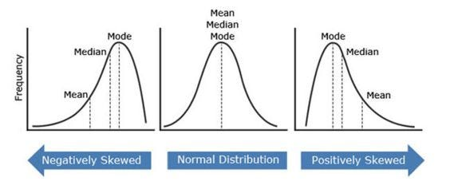
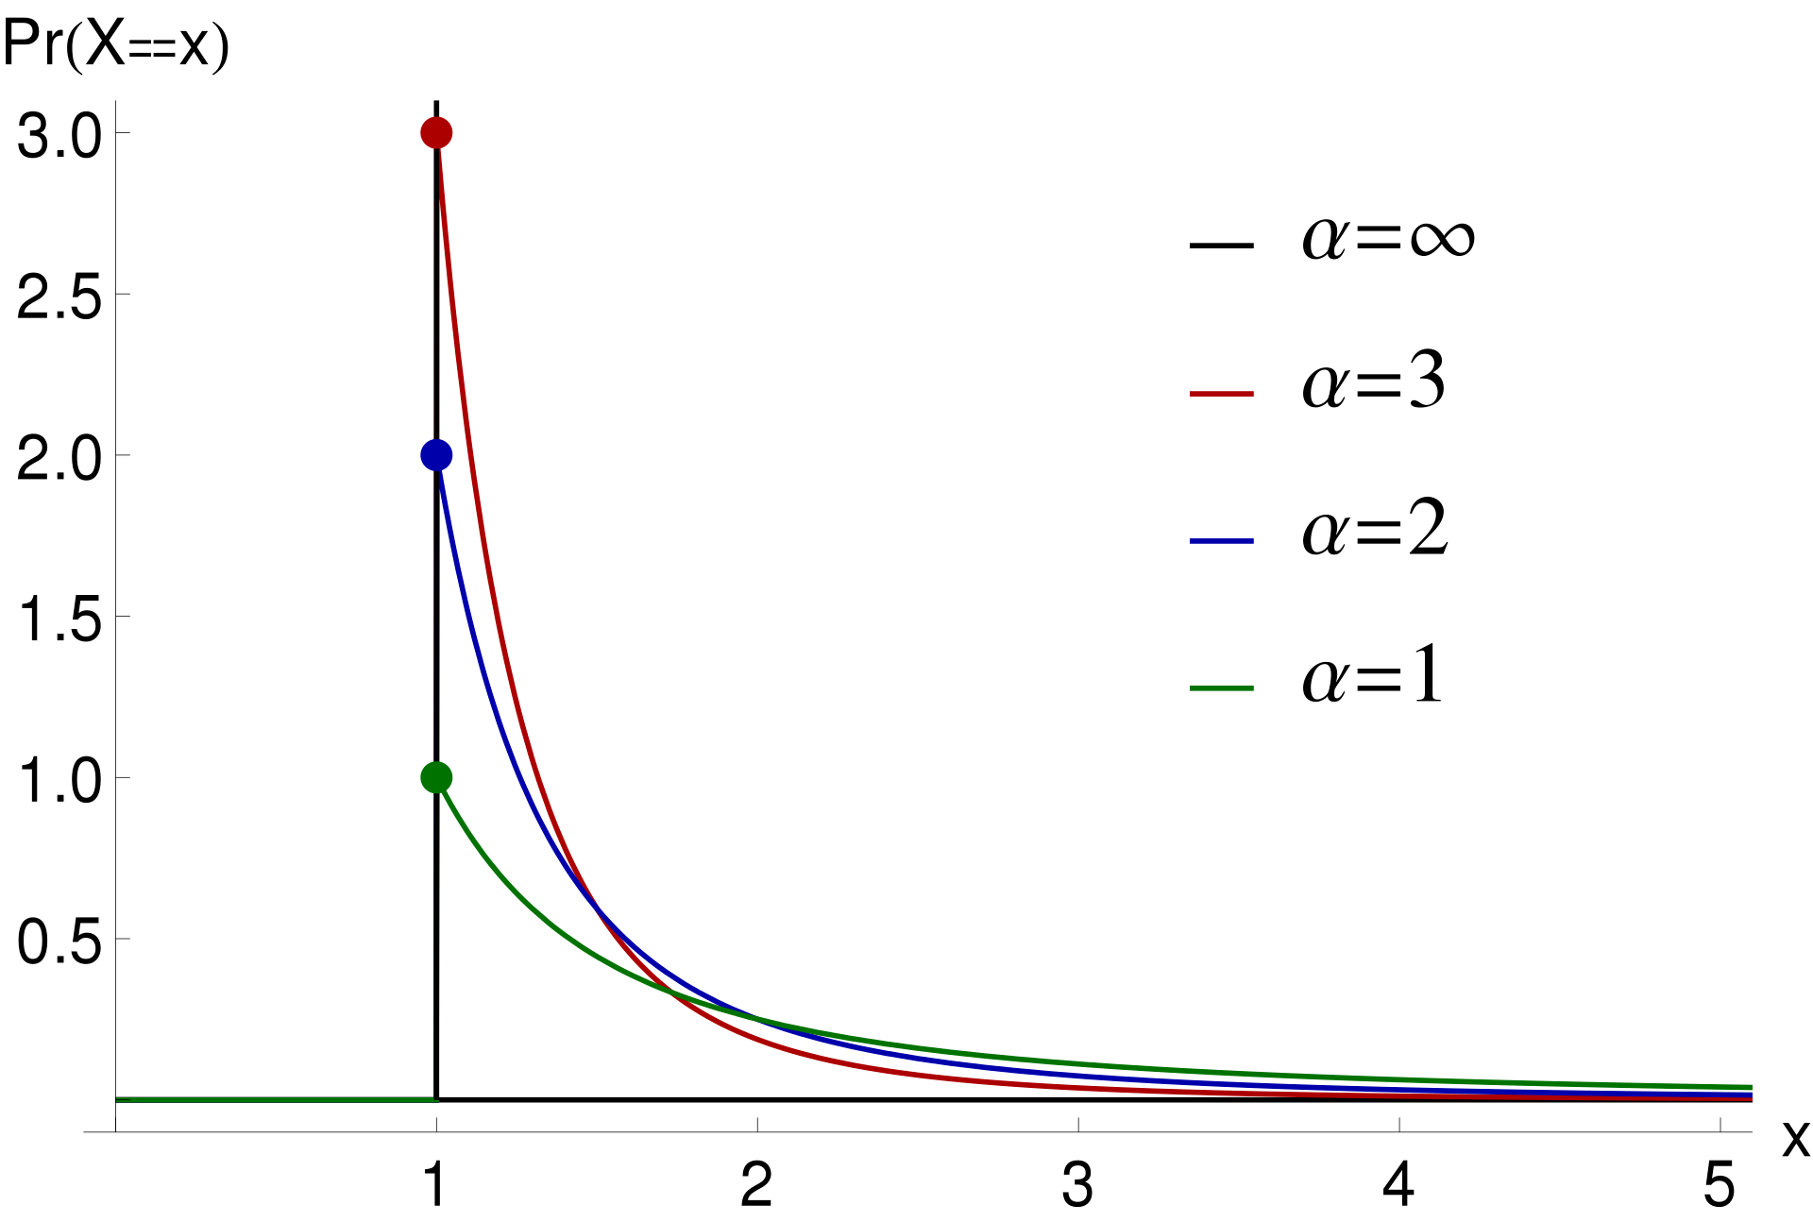
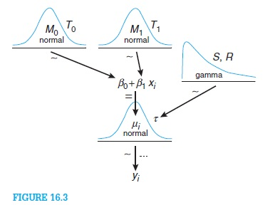
Cutpoint Options
Devanarayan et al., 2017
Pugh et al., 2024
LeBlond et al. (2022)
Traditional Approach
Extreme Value Theory
Bayesian Model
Wikipedia
Kruschke et al. 2014
Navlani, 2015, Medium
Define cutpoint based on distance from central tendencies
Mean + scalar*SD
Median + scalar*MAD
Percentiles
Define cutpoint based on the tail rather than central tendency
Fit Pareto Distribution to describe tail
Find percentiles of that distribution
Define cutpoint based on a model of the data generating process
Fit a model that describes data generation
Estimate posterior distributions
Find percentiles of posterior distributions

Slide 8
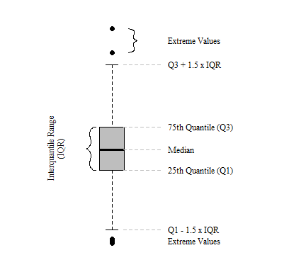
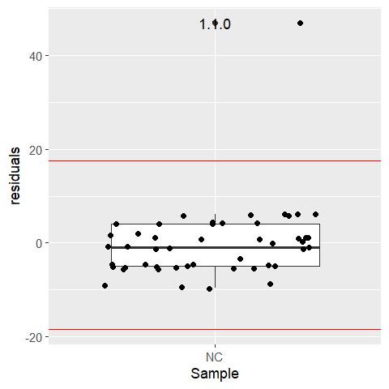
Cutpoint Analysis Workflow (Devanarayan, 2017)
1. NC Outlier Analysis
Fit the most complicated model possible to explain data; examine model
Conduct Tukey Boxplot Analysis on Residuals to Identify Outliers Replicates
Screening :
2. S/N Outlier Analysis
Confirmatory:
2. IR
Outlier Analysis
Model in R Notation
NCSignal~Run*Plate+(1|Analyst)
Simulated Data
3. S/N
Best Linear Predictor Analysis
3. IR
Best Linear Predictor Analysis
4. Determine Cutpoints
4. Determine Cutpoints
Julian, 2020
S/N is signal-to-noise ratio: NHPsample/NC
IR is inhibition ratio: 100*(1-(NHP sample + drug /,eaNHP drug free sample))

Slide 9
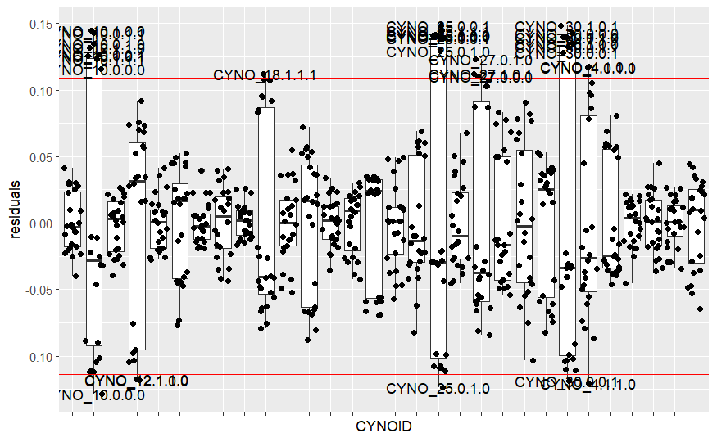
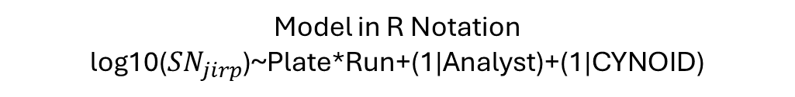
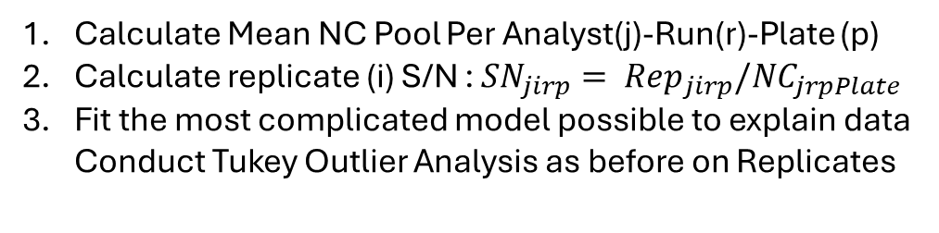
Cutpoint Analysis Workflow (Devanarayan, 2017)
Calculate Mean NC Pool Per Analyst(j)-Run(r)-Plate (p)
Calculate replicate (i) S/N : ${SN}_{jirp}= {Rep}_{jirp}/{NC}_{jrpPlate}$
Fit the most complicated model possible to explain data Conduct Tukey Outlier Analysis as before on Replicates
1. NC Outlier Analysis
Screening :
2. S/N Outlier Analysis
Confirmatory:
2. IR
Outlier Analysis
Model in R Notation
log10(${SN}_{jirp}$)~Plate*Run+(1|Analyst)+(1|CYNOID)
Simulated Data
3. S/N
Best Linear Predictor Analysis
3. IR
Best Linear Predictor Analysis
4. Determine Cutpoints
4. Determine Cutpoints
S/N is signal-to-noise ratio: NHPsample/NC
IR is inhibition ratio: 100*(1-(NHP sample + drug /,eaNHP drug free sample))

Slide 10
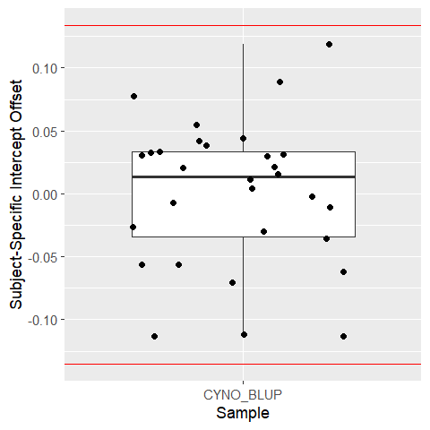
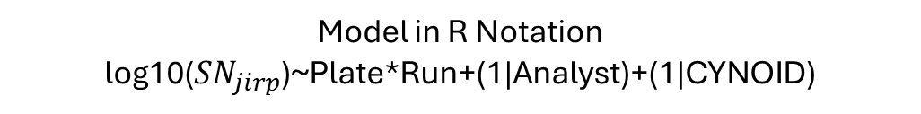
Cutpoint Analysis Workflow (Devanarayan, 2017)
1. NC Outlier Analysis
Remove outliers identified in prior step.
Re-estimate prior model and extract BLUPs BLUPs = Best Linear Unbiased Predictors; here this refers to the random-intercept estimate for each CYNO
Conduct Tukey Outlier Test with BLUPs to identify biological outliers
Screening :
2. S/N Outlier Analysis
Confirmatory:
2. IR
Outlier Analysis
Model in R Notation
log10(${SN}_{jirp}$)~Plate*Run+(1|Analyst)+(1|CYNOID)
Simulated Data
3. S/N
Best Linear Predictor Analysis
3. IR
Best Linear Predictor Analysis
4. Determine Cutpoints
4. Determine Cutpoints
S/N is signal-to-noise ratio: NHPsample/NC
IR is inhibition ratio: 100*(1-(NHP sample + drug /,eaNHP drug free sample))

Slide 11
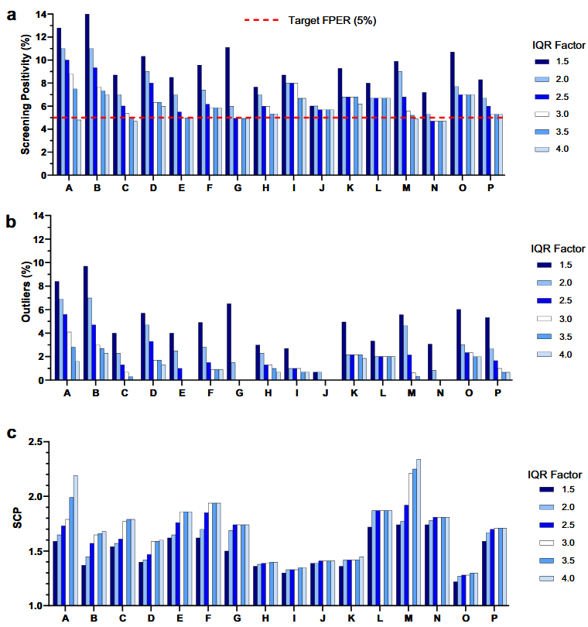
Outlier Removal May Not Be Ideal
Let’s pause here…
Inhibition ratio (IR) also starts with an outlier analysis
These outlier analyses may not be necessary, and in some cases may throw out useful information (Garlits et al., 2023)
1. NC Outlier Analysis
Screening :
2. S/N Outlier Analysis
Confirmatory:
2. IR
Outlier Analysis
3. S/N
Best Linear Predictor Analysis
3. IR
Best Linear Predictor Analysis
4. Determine Cutpoints
4. Determine Cutpoints
S/N is signal-to-noise ratio: NHPsample/NC
IR is inhibition ratio: 100*(1-(NHP sample + drug /NHP drug free sample))
Garlits et al. (2023)

Slide 12
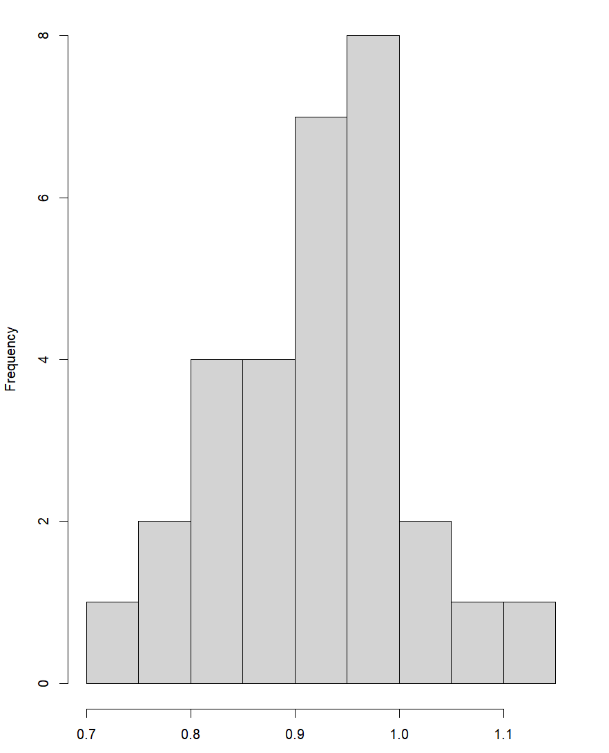
Determine Screening Cutpoints
Mean S/N calculated per CYNO and then distribution assessed
1. NC Outlier Analysis
Screening :
2. S/N Outlier Analysis
Confirmatory:
2. IR
Outlier Analysis
SCP should have a 5% FP rate with 90% confidence
3. S/N
Best Linear Predictor Analysis
3. IR
Best Linear Predictor Analysis
Log(S/N Ratio)
Yes
*Normal?
No
Parametric CP
Mean + 1.645*SD
Median + 1.645*MAD
4. Determine Cutpoints
4. Determine Cutpoints
Non-Parametric
90th Percentile
S/N is signal-to-noise ratio: NHPsample/NC
IR is inhibition ratio: 100*(1-(NHP sample + drug /NHP drug free sample))

Slide 13
Determine Confirmatory Cutpoints
Mean IR calculated per CYNO and then distribution assessed
1. NC Outlier Analysis
Screening :
2. S/N Outlier Analysis
Confirmatory:
2. IR
Outlier Analysis
CCP should have a 1% FP rate with 80% confidence
3. S/N
Best Linear Predictor Analysis
3. IR
Best Linear Predictor Analysis
IR Ratio
Yes
*Normal?
No
Parametric CP
Mean + 2.33*SD
Median + 2.33*MAD
4. Determine Cutpoints
4. Determine Cutpoints
Non-Parametric
99th Percentile
S/N is signal-to-noise ratio: NHPsample/NC
IR is inhibition ratio: 100*(1-(NHP sample + drug /NHP drug free sample))

Slide 14
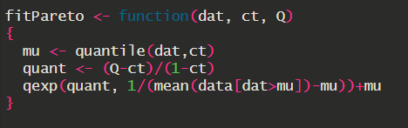
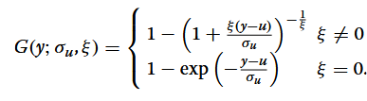
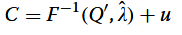
Extreme Value Theory (Pugh et al. 2024)
The parametric approach (read: normal distribution) overly relies on the center mass of the distribution when what we care about are the tails –- the extreme values.
We may be essentially misfitting the data, leading to a misestimated cutpoint (exacerbated by outlier removal)
Log(S/N Ratio)
Pareto Distribution
Exponential Approximation for small Ns

Slide 15

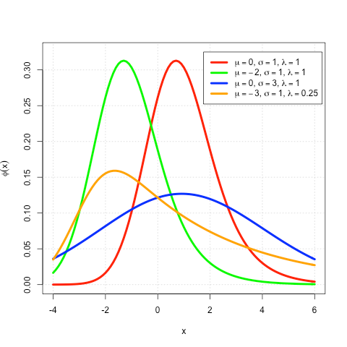
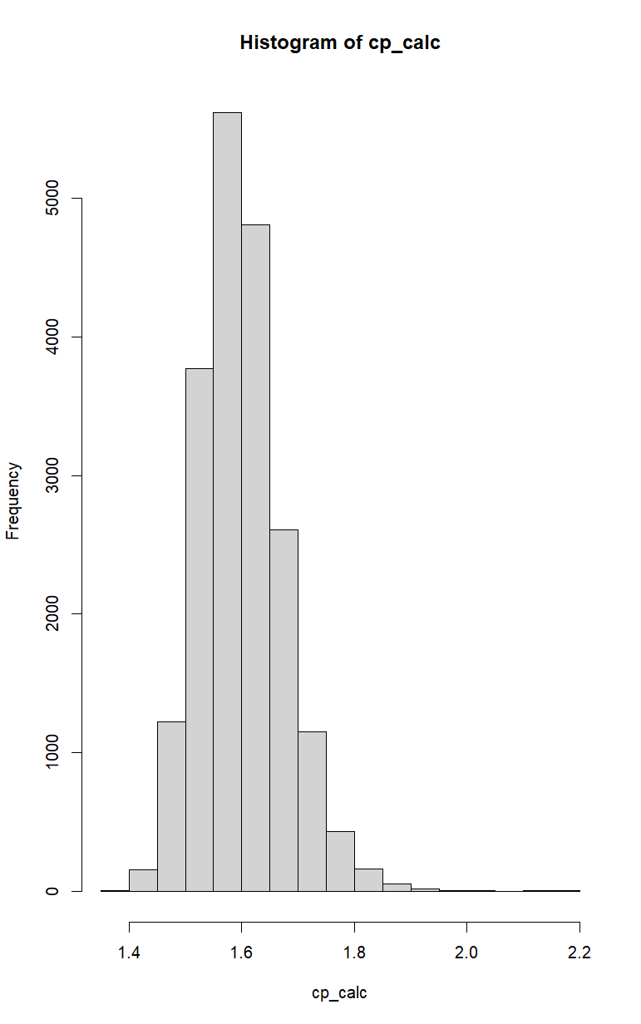


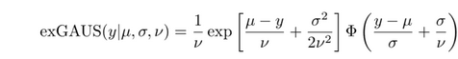
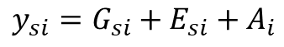
Bayesian exGuassian (LeBlond et al. 2022)
Parametric, Non-Parametric, Extreme-Value are lossy procedures because we’re relying on distribution components (central tendency or tails) of the mean per CYNO
To avoid lossy procedures, we can
model different sources of error at the CYNO and replicate level in a distribution that
adequately models both the central tendency and distribution tails.
LeBlond et. al. (2022) makes an argument for Bayesian estimation of an exponentially modified Gaussian (exGaussian) distribution.
Why Bayes? When we estimate posterior distributions given prior distributions and a data model, we capture uncertainty and thus provide information for at-risk decisions.
Log(S/N Ratio)
exGaussian (Wikipedia)
CP = 90th percentile of Posterior ExGaussian
$$y_{si}=G_{si}+E_{si}+A_{i}$$
Analytical variation
$$G_{si} \sim N\left(μ,σ^{2}\right), E_{si} \sim Exp\left(υ\right), A_{i} \sim N(0,σ_{A}^{2})$$
Subject-specific variation
CP Posterior distribution

Slide 16
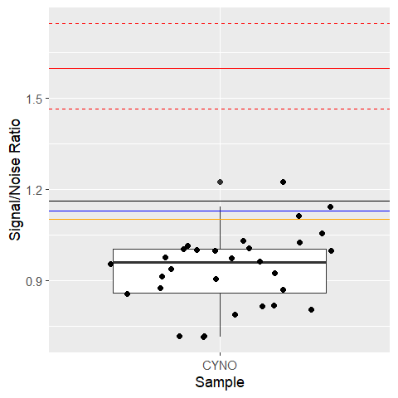
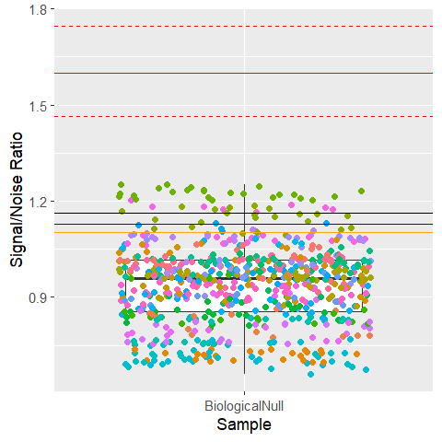
Screening Cutpoint Results
(1) Distribution of Mean CYNO S/N
with cutpoints
(2) Distribution of CYNO S/N Replicates
with cutpoints from (1)
Bayes
Mean
Pareto
Median
The Bayesian approach appropriately models the data as replicates nested within individuals affected by analytical variation. As a result, it yields the CP most removed from the central tendency of naïve individuals. Thus, values above the Bayesian CP are truly positive
Note: Calculations conducted on log scale and back transformed to the ratio for ease of interpretation.

Slide 17
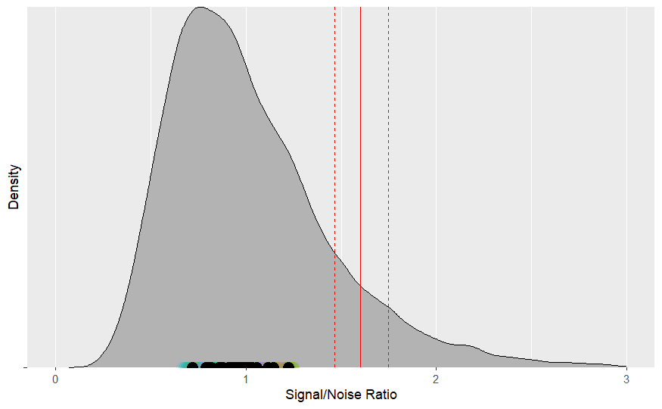
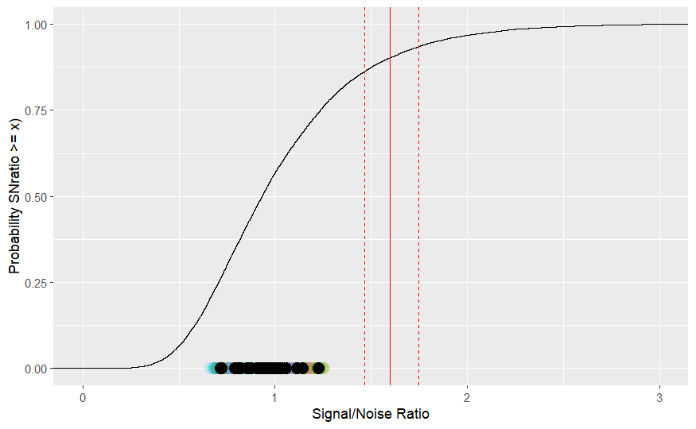
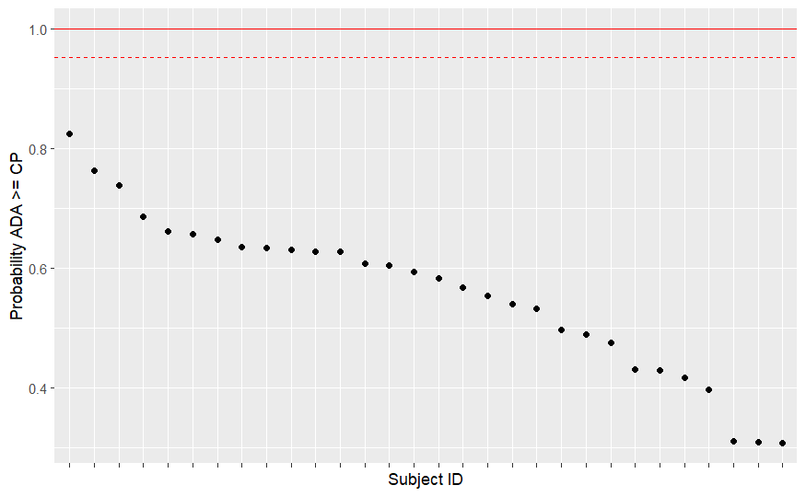
Staging Individuals By the Bayesian Cutpoint
Full Posterior ExGaussian Distribution
Empirical Cumulative Distribution (ECD)
Probability ADA >= CP (π)
Cutpoint with 95% HDI
Mean CP and greater
Lower HDI = 0.95
Subject
Replicates
Subject Means
π = ECD/ ECD at mean CP
if π > 1, π → 1
Bayesian estimation of the exGaussian let us stage individuals by the rescaled ECD and thus represent individuals by the probability and uncertainty with which a subject is greater than or equal to the cutpoint.
Thus, the Bayesian method lets us better understand subjects and their relationship to the cutpoint.

Slide 18



Selecting a Cutpoint Method
Documented my work
Methods Presented to Cross-functional meeting of Bioanalytical, Pre-clinical, & QA
Pugh et al. (2024)
AI generated
Pugh et al. (2024)
Balanced rigor with
ease of use
interpretability, and
easily accommodated by existing SOPs
Devanarayan (2017)
LeBlond et. al. (2022)
Went on to successfully use the EVT method in our NHP-GLP study
What would I do differently?
Better educate on the virtues of Bayesian statistics and package the method into an R-Shiny app so others could use the method independently of myself.

Slide 19
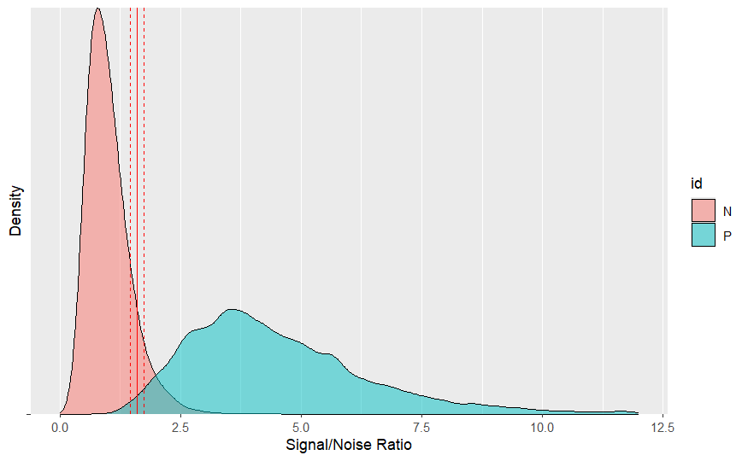
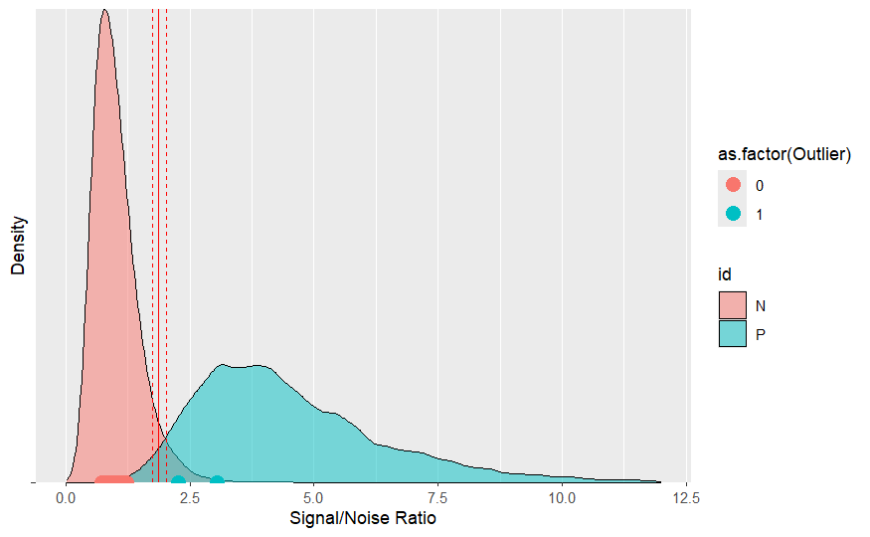
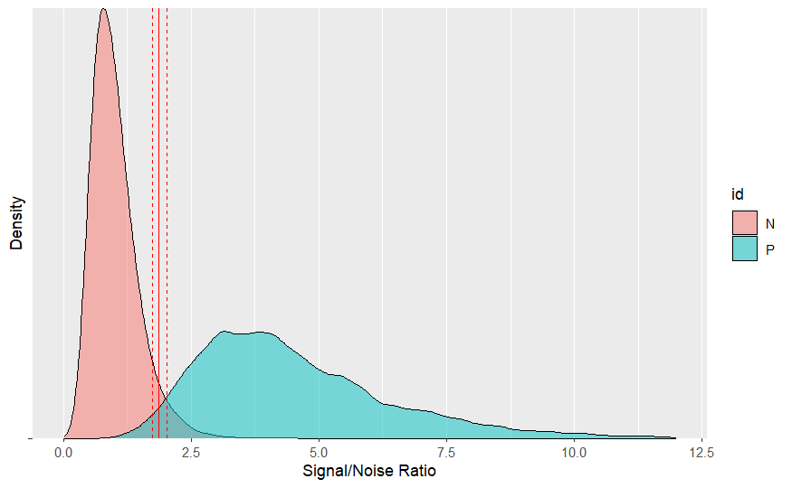
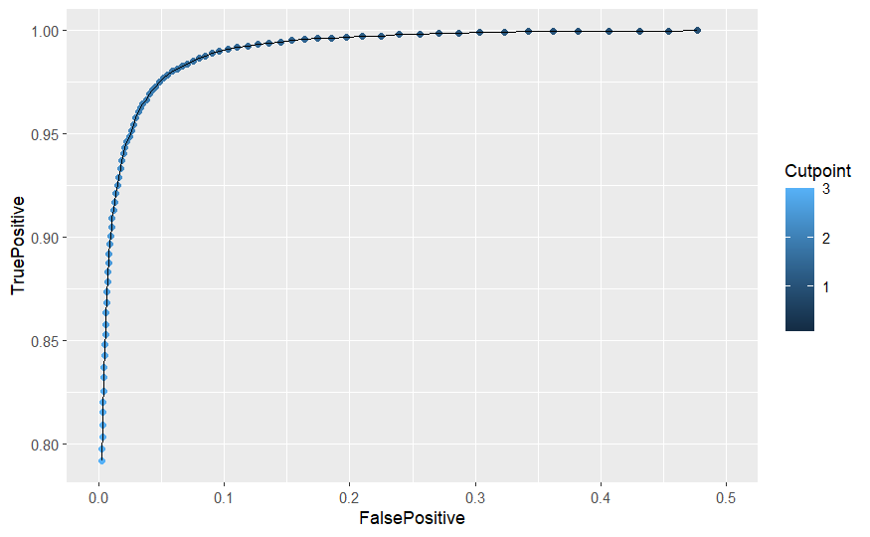
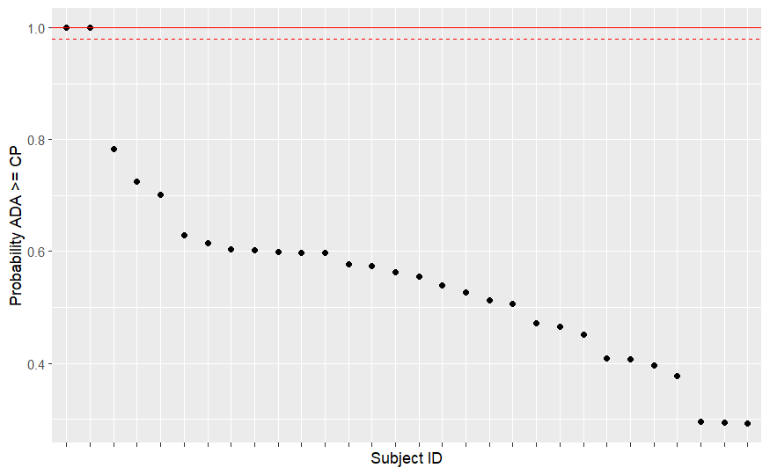
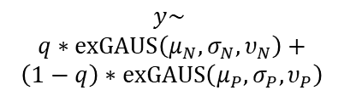
A Proposal for Capsid Antibody Cutpoints
Outlier Analysis to Identify (not remove) Potential ADA+ Subjects
Mixture distribution fit
to entire dataset*
Format and prep data for analysis
Cutpoint based on N distribution
$$y\sim$$
$$q∗exGAUS\left(μ_{N},σ_{N},υ_{N}\right)+$$
$$\left(1−q\right)∗exGAUS\left(μ_{P},σ_{P},υ_{P}\right)$$
Sensitivity Analysis to find optimal cutpoint
Verify outlier location
Stage by π
Cutpoint based on ROC
Analysis
ΔCP = 0.275
ROC analysis Varied CP and calculated TP and FP rate
*Color coding is to show the different components of the mixture; we’re saying each data point has some probability (q) of coming from the naïve cohort and a complement probability (1-q) coming from the positive cohort. Also note, theoretically this mixture distribution method could be used anywhere we expect ADAs are present prior to drug administration.

Slide 20
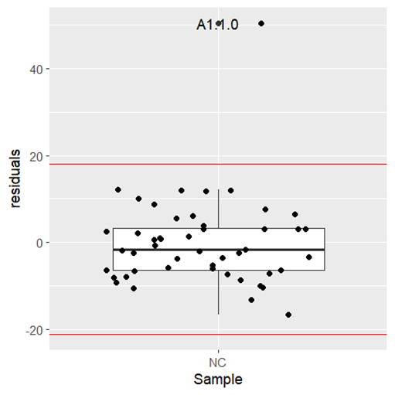

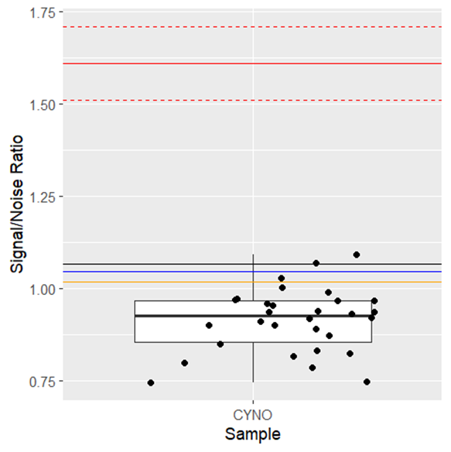

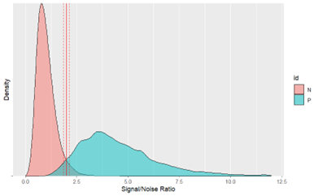


Conclusions
ADA assays for gene therapies
Collected/Simulated Data
Outlier Analysis
Defined cutpoints
Compared Cutpoint Methods
Cross-functionally chose a method
Proposed Capsid-Specific Method
Implement In-Study
AI generated
My general philosophy: Build models that encode what we know about the data generation process so that we can build principled models that naturally accommodate at-risk decisions by estimating uncertainty (i.e., Bayes).

Slide 21
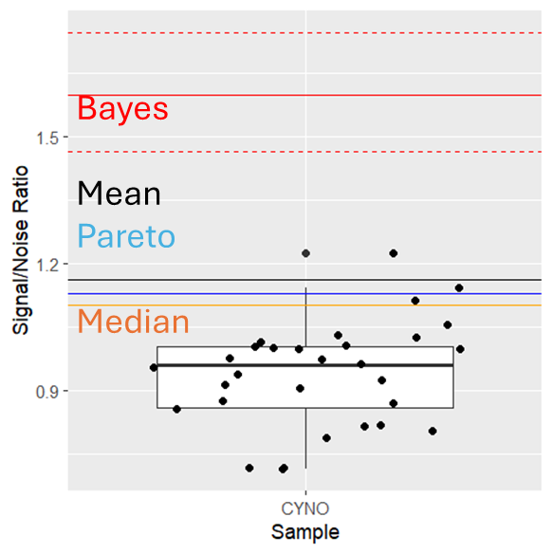
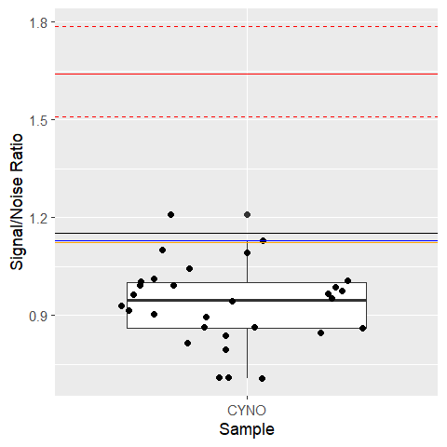
Backup Slides: Estimation w/Outliers
Outliers Culled
Outliers Retained

Slide 22
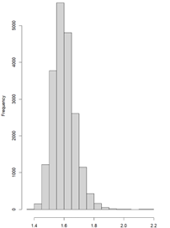
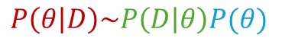
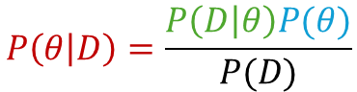
Bayesian Models: How They Work
$$P\left(θ | D\right)=\frac{P\left(D | θ\right)P(θ)}{P(D)}$$
Prior Distributions
$$P\left(θ | D\right)\sim P\left(D | θ\right)P(θ)$$
Estimate with Monte Carlo Markov Chains
Initialize sampler based on priors; current = initialize
Sample proposal from prior
Compare proposal to current
Based on criteria, reject or retain proposal
Set current equal to proposal
Repeat (2) – (5) until convergence on posterior
MCMC Methods differ in how exact implementation
Kruschke et al. 2014
Likelihood function
Posterior Distributions
p(parameters|data)

Slide 23
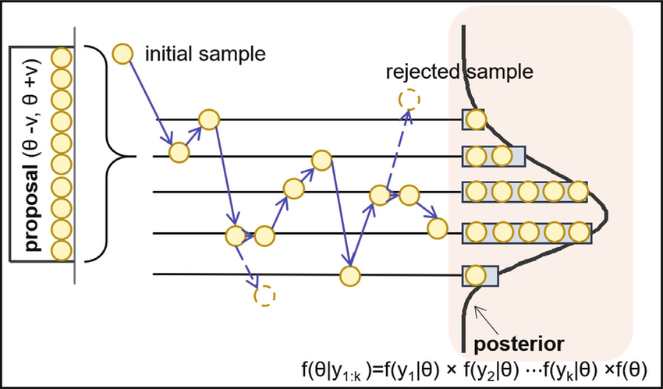
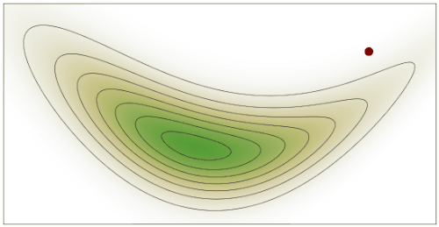
Backup Slides: Estimation of Bayesian Models
Dong et al. 2019
Wikipedia

Slide 24

Backup Slides: Convergence of the Bayesian Model

Slide 25

Backup Slides: Chain Mixing

Slide 26

Backup Slides: Autocorrelation

Slide 27

LeBlond et al. (2022) recommended implementation
Variance of G
Biological variability
G ~ Normal
E ~ exponential
Priors; If unspecified then U(-2,2)
Analytical variation

